Slide 1
Lightning Presentation
By Charles Yau
8th July 2017

Slide 2



Main interests are Technology, People and Music

Slide 3
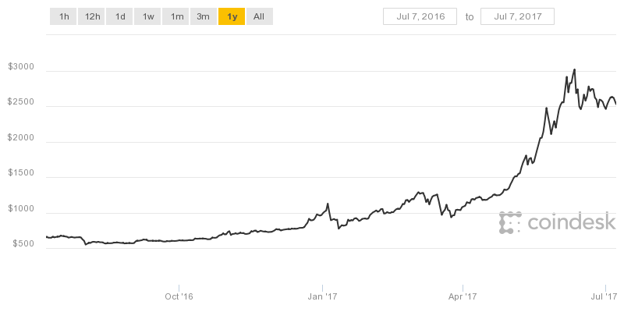
Problem: Cryptocurrencies are a high risk investment, how can we utilize public speculation to alleviate some of the ambiguity and predict the price?
Extremely volatile
Attempting to find a correlation between the price and speculation
It matters to anyone who is potentially looking into blockchain or cryptocurrencies as a whole

Slide 4



Data: Publicly available historical pricing and twitter APIs
Bitcoin and Ethereum datasets are publicly available on Kaggle
Twitter API could be used to gain news on blockchain/cryptocurrencies
If the presence of a relationship can be established (or the lack thereof) it can be considered a success
Null Hypothesis:
There is no relationship between news on cryptocurrencies/blockchain and the price of the most famous cryptocurrencies

Slide 5

Problem: With privacy issues on the rise, how can digital marketers paint an accurate picture of who their target user is just based on user behavior
Consent to background data collection is almost the norm these days
However, voluntary input of a user’s demographic is generally harder to achieve
Attempting to find out what demographic a customer belongs to without explicitly inconveniencing or asking them
Digital marketers, analysts, strategy heads etc.

Slide 6

Data: TalkingData Kaggle Competition
TalkingData is China’s third largest mobile data platform
350 million data points from Chinese users
Getting demographics based on app usage, geolocation and mobile device properties can be considered a success
Null Hypothesis:
There is no relationship or correlation between app usage or mobile device properties which can determine the demographic of a user

Slide 7

Problem: As an aspiring artist, I would like to be able to achieve viral success, but with so many artists to compete with, how can I generate an original but viral song?
The music industry is extremely competitive, how can you achieve critical acclaim through differentiation (or lack thereof) in this day and age?
Attempting to find a correlation between the lyrics of songs and how famous they got
If we can make a song out of the most famous lyrics in the past couple of years, it would probably have a higher chance of success

Slide 8

Data: 55,000+ Song lyrics and Now That’s What I Call Music Tracklistings (60 albums)
Both datasets publicly available on Kaggle and contains full information on artists, lyrics, albums and duration
If we can find a correlation between the top hits and lyrics used (or lack thereof), it would be a success
Null Hypothesis:
There is no relation between lyrics used and popularity of a song/artist

Slide 9
Thanks for listening!
Q&A

